Slide 1
Flock
Smart Vehicle to Vehicle Technology using IoT

Slide 2
Abstract
To decrease commute time as well as enable multi-vehicle control by a single driver using GPS and Ultrasonic sensors using the concepts of IoT and Machine Learning.

Slide 3
Technologies Used
Keras (Machine Learning)
NodeMCU (IoT Client - Server communication)
Arduino
Bluetooth
Flask (Website Backend and Database)
HTML, CSS, JavaScript

Slide 4
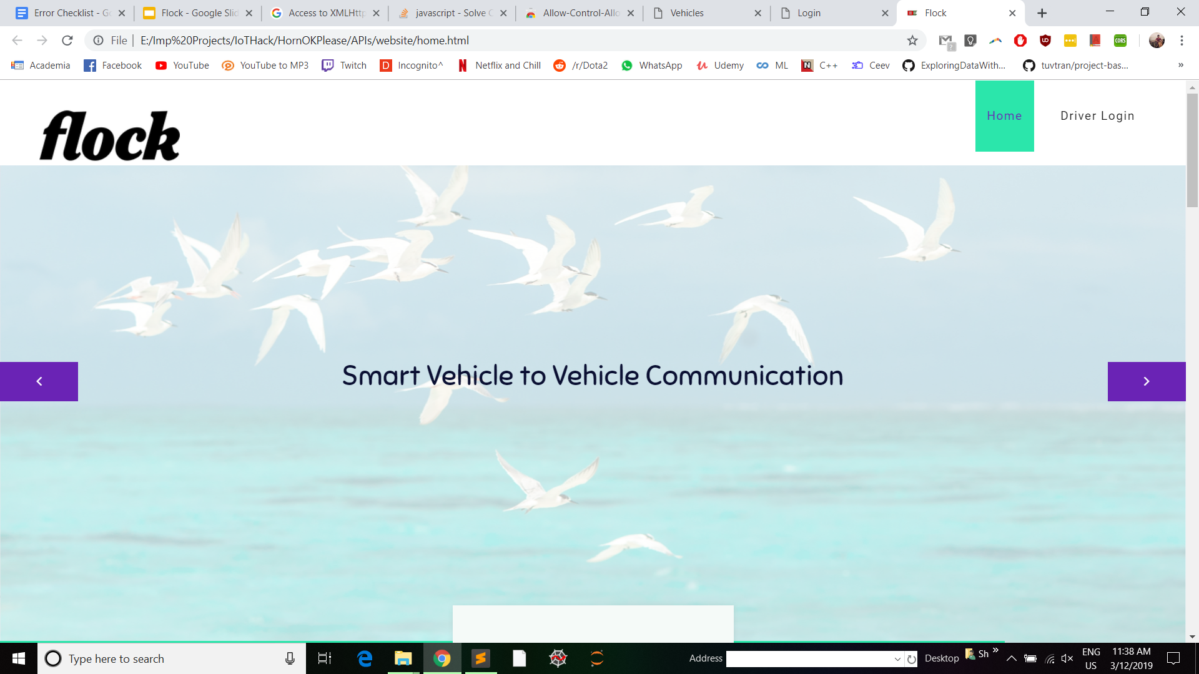

Slide 5
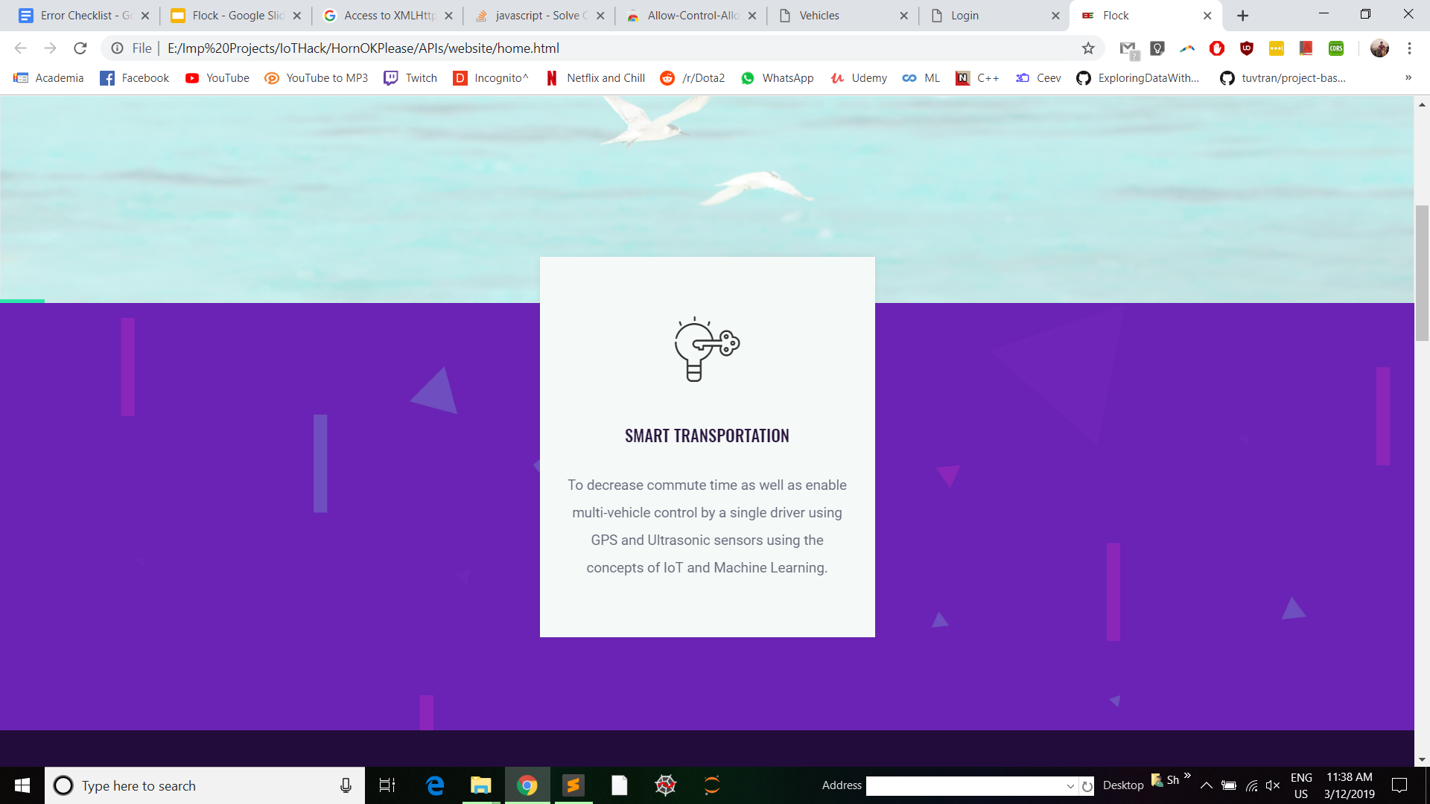

Slide 6
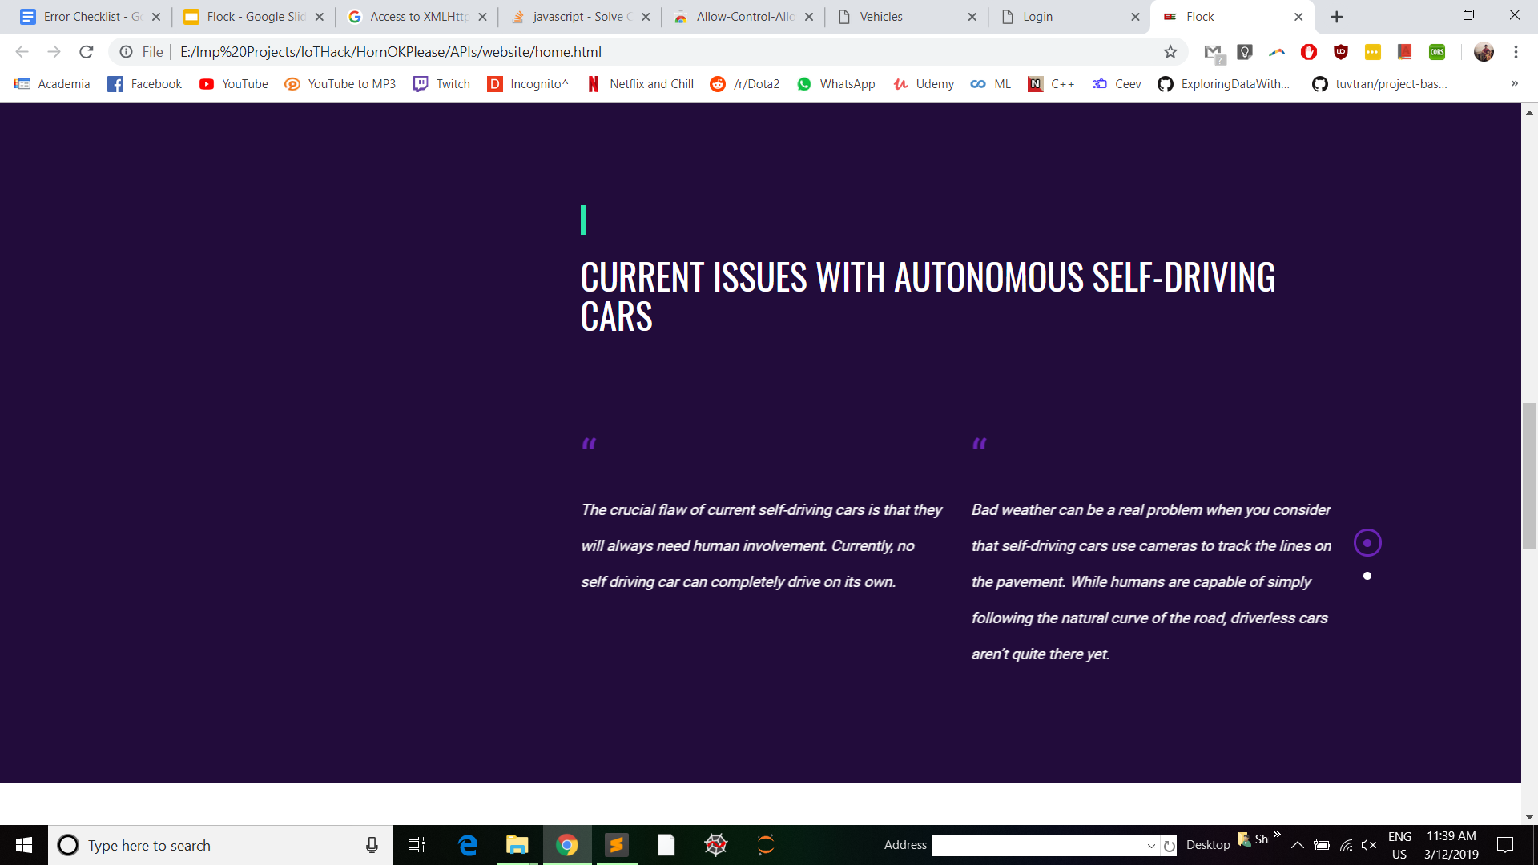

Slide 7
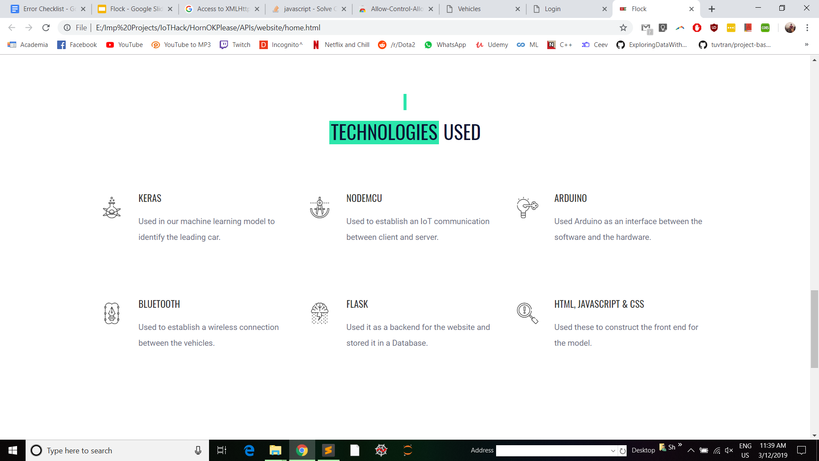

Slide 8
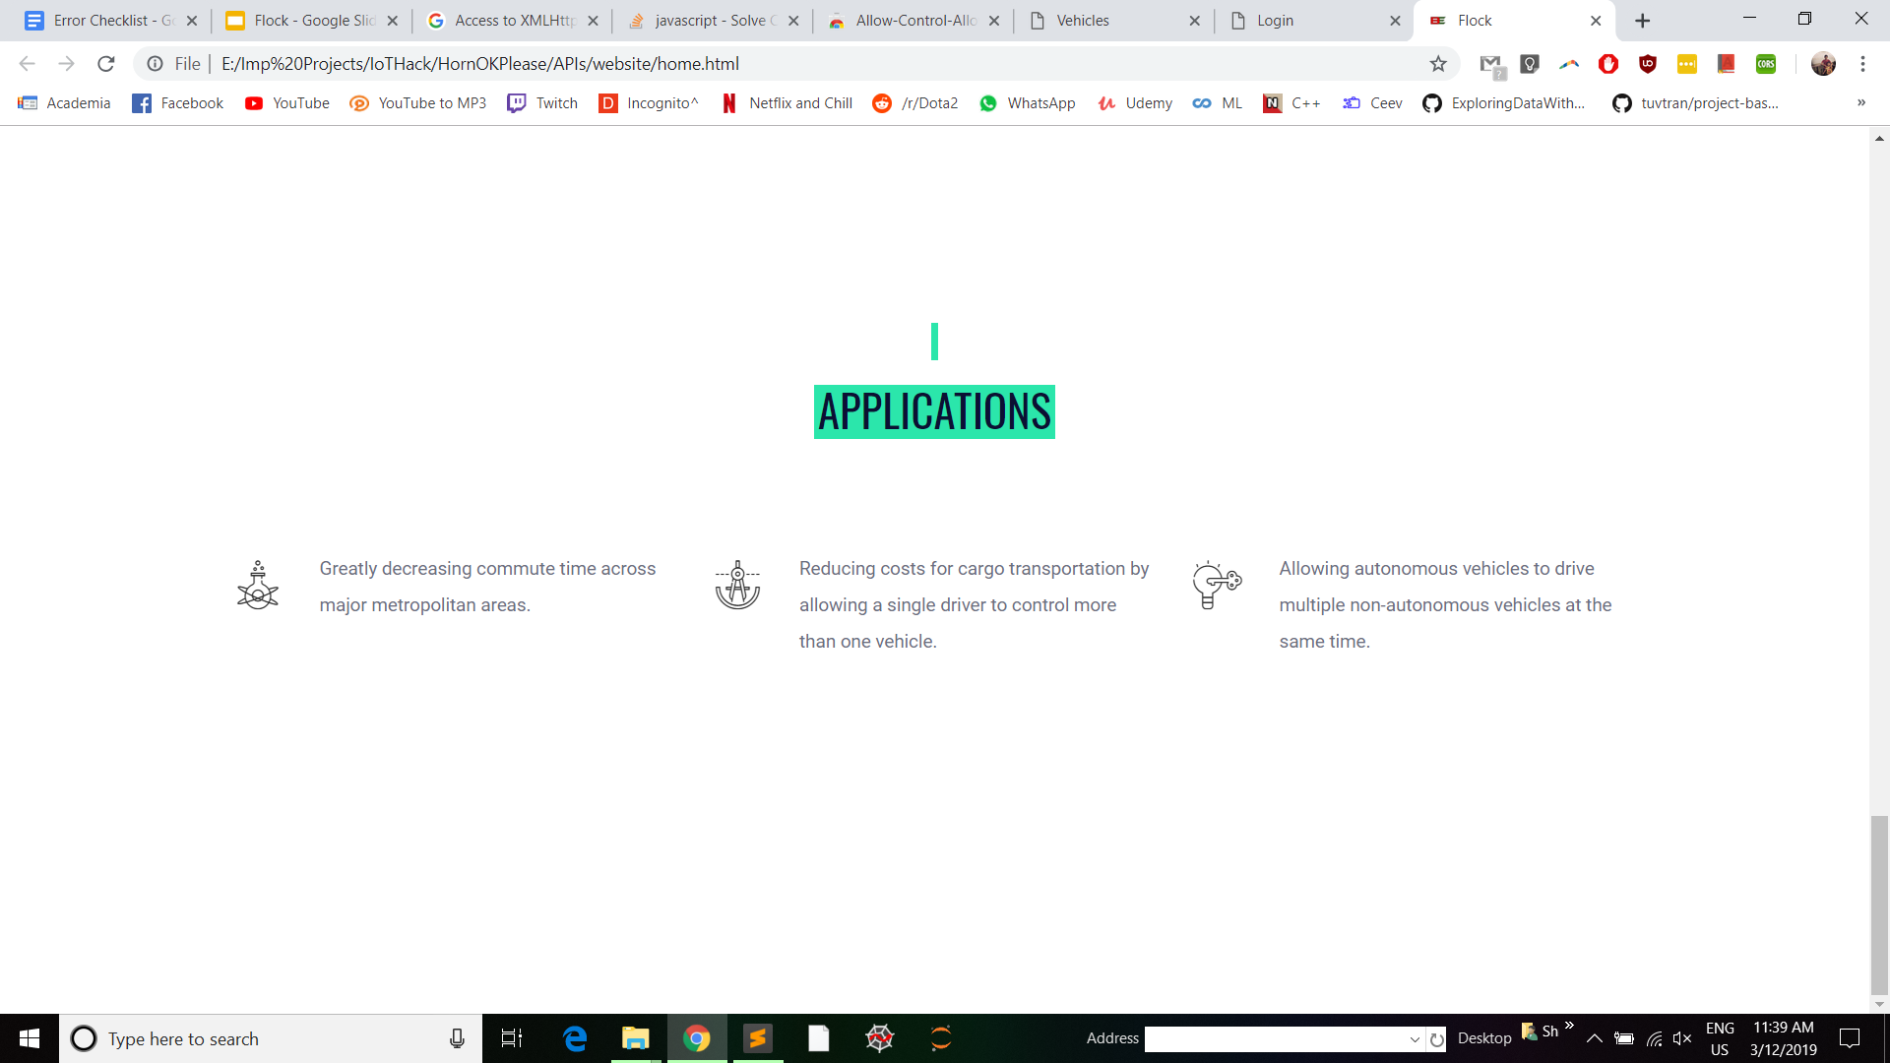

Slide 9
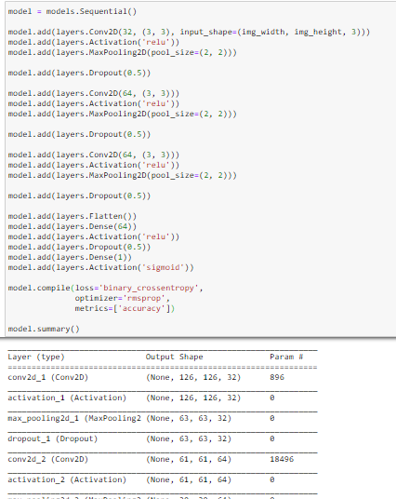

Slide 10
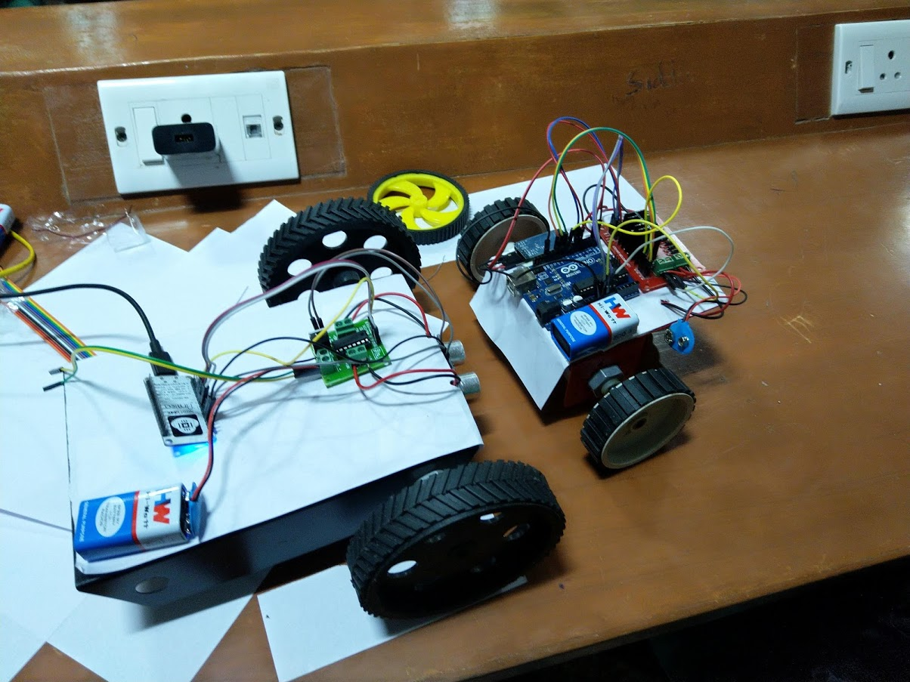

Slide 11
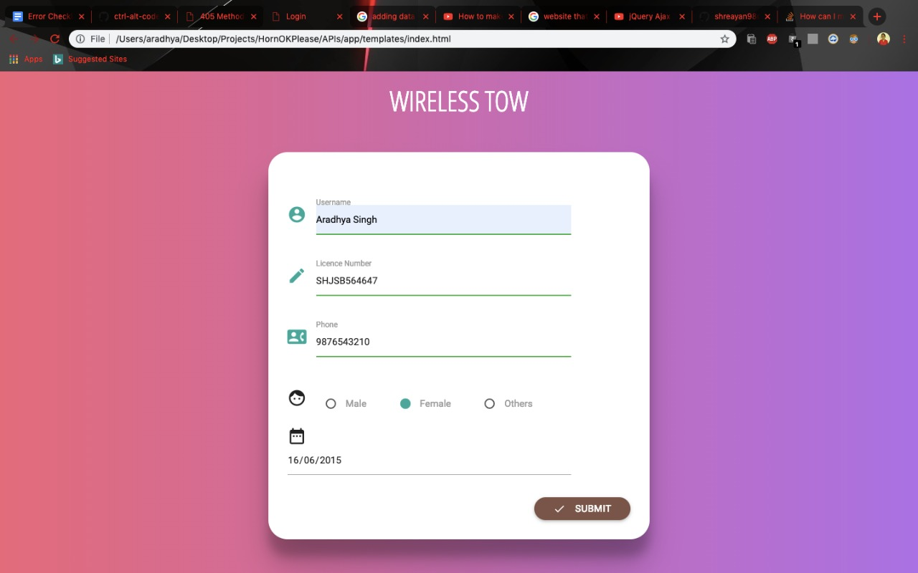

Slide 12
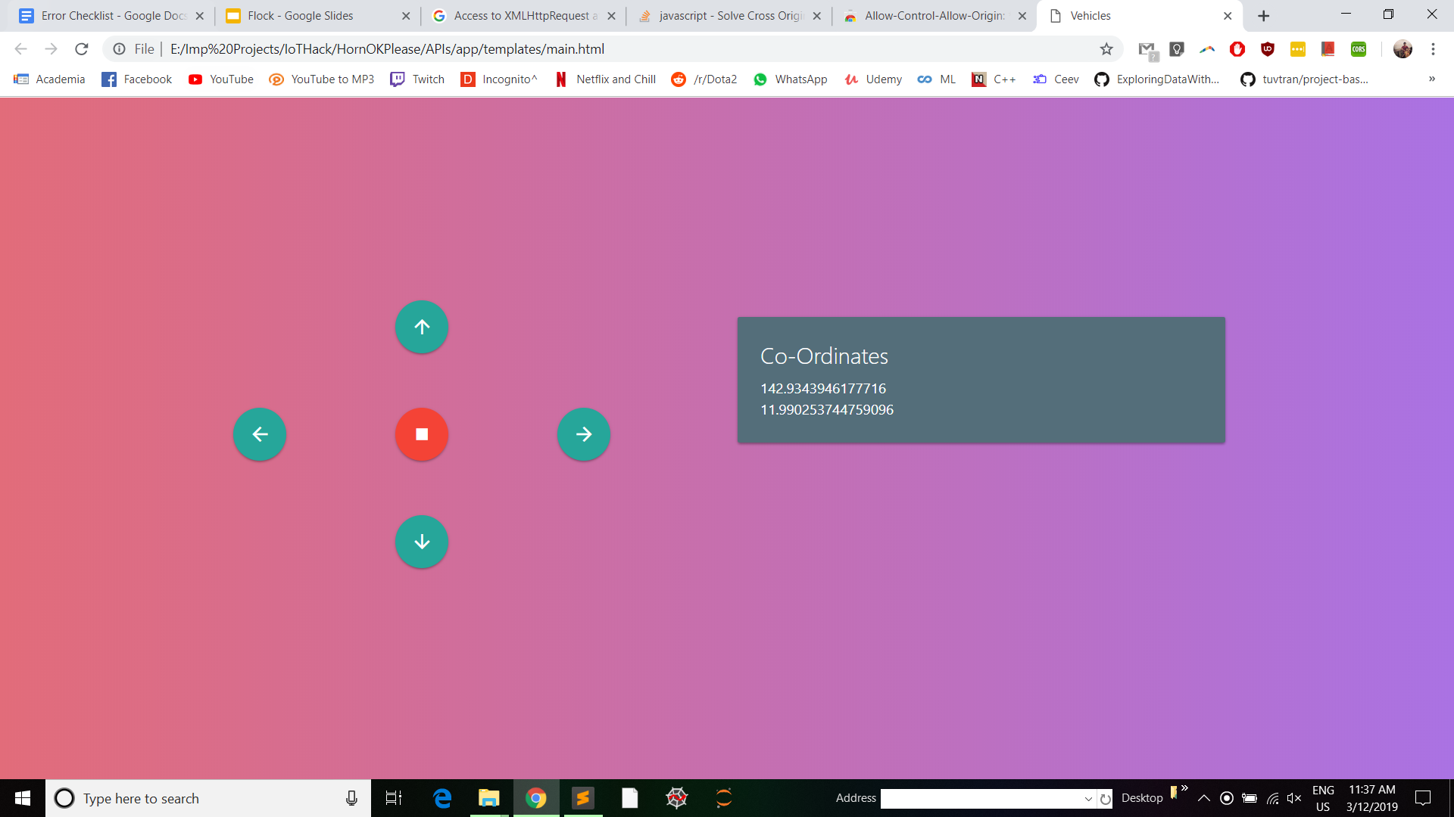

Slide 13
Applications
Greatly decreasing commute time across major metropolitan areas
Reducing costs for cargo transportation by allowing a single driver to control more than one vehicle.
Allowing autonomous vehicles to drive multiple non-autonomous vehicles at the same time. As we know, autonomous vehicles aren't as safe as we need them to be. Instead a driver can supervise more than one vehicle. Multiple safety procedures will be added to this project to prevent accidents.

Slide 14
Large Scale Implementation
This can be developed into a large scale Vehicle To Vehicle (V2V) network where each vehicle knows what the vehicles in their vicinity is doing. (Speed, emergencies, traffic, etc.)
We believe this idea has large potential for bringing change to a pressing problem.

Slide 15
Thank You!
Made By:
Shreayan Chaudhary
Prabhat Singh
Aradhya Singh
Siddharth Jain
College: SRM Institute of Science and Technology

